Slide 1
Analysing Data Science Job posts & Predicting their Salary using Machine Learning Algorithms
CA653 Assignment
Nikhil Kolloju
Sai krishna Raghu Teja manchala
Karthik gandharapu
Sai Dinesh vasamsetti

Slide 2
Introduction
Data science occupations have risen in popularity in the employment industry in recent years, thanks to the growing relevance of big data in sectors throughout the United States.
Since 2012, there has been a 650 percent rise in jobs in the world of data science, according to major job-posting websites.
What qualifications are in more demand? Which role offers the highest salary? Which Location has more jobs?
What factors influence the salary of a Data Science Job?

Slide 3
Research question
Which Machine Learning Model can best predict the salary of Data Science jobs?

Slide 4
PROCESS FLOW: crisp-dm
Understanding the Problem
Understanding the Data
Preparing
the Data
Modelling the Data
Evaluating the Data
Deployment and Discussion

Slide 5
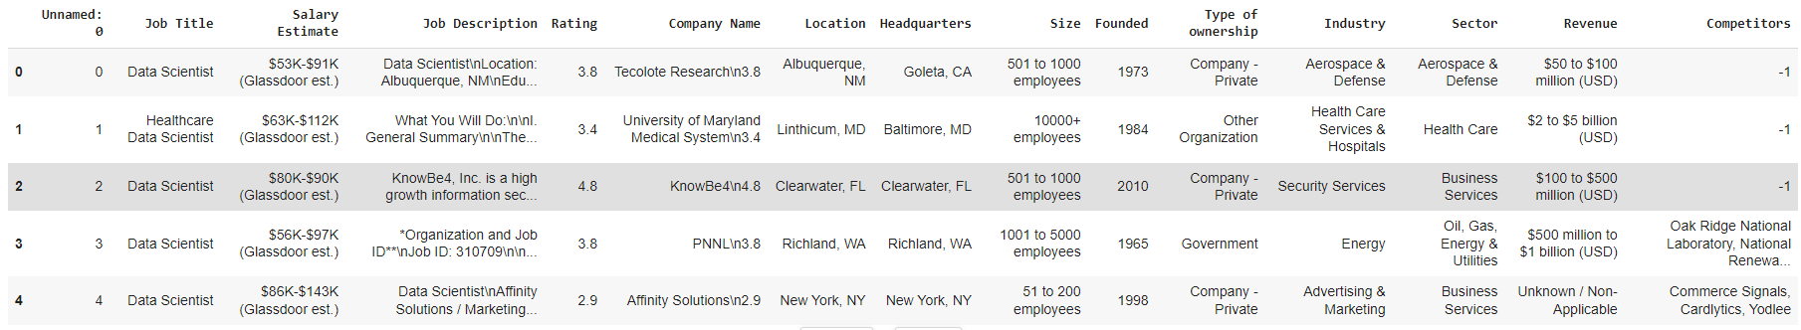
Dataset
Source: Glassdoor
Data Format: Web-scrapped job posts from the website.
Volume: 100,000 rows and 15 rows.
Input Variables: Job Title, Salary, Job Description, Rating, Location, Size, Founded, Industry, Sector
Output Variable: Average Income
Sample Dataset:

Slide 6
Related work
R. Magel and M. Hoffman, "Predicting Salaries of Major League Baseball Players", International Journal of Sports Science, vol. 5, no. 2, pp. 51-58, 2015. IEEE.
Viroonluecha, P. and Kaewkiriya, T., 2018, September. Salary Predictor System for Thailand Labour Workforce using Deep Learning. In 2018 18th International Symposium on Communications and Information Technologies (ISCIT) (pp. 473-478). IEEE.
Dawson, N., Rizoiu, M.A., Johnston, B. and Williams, M.A., 2020, December. Predicting skill shortages in labor markets: A machine learning approach. In 2020 IEEE International Conference on Big Data (Big Data) (pp. 3052-3061). IEEE.
Khongchai, P. and Songmuang, P., 2016, January. Random forest for salary prediction system to improve students' motivation. In 2016 12th International Conference on Signal-Image Technology & Internet-Based Systems (SITIS) (pp. 637-642). IEEE.
Mishra, P., Srivastava, S., Gupta, P., Anand, A. and Gupta, S.C., 2021, December. A Comparative Study of Machine Learning Algorithms for Salary Estimation. In 2021 3rd International Conference on Advances in Computing, Communication Control and Networking (ICAC3N) (pp. 1698-1703). IEEE.
Hu, Z., Zhu, J. and Tse, K., 2013, November. Stocks market prediction using support vector machine. In 2013 6th International Conference on Information Management, Innovation Management and Industrial Engineering (Vol. 2, pp. 115-118). IEEE.
Kavitha, S., Varuna, S. and Ramya, R., 2016, November. A comparative analysis on linear regression and support vector regression. In 2016 online international conference on green engineering and technologies (IC-GET) (pp. 1-5). IEEE.
Kim, H. and Han, S.T., 2016. The enhanced classification for the stock index prediction. Procedia Computer Science, 91, pp.284-286.
Kumar, P. and Bala, A., 2016, August. Intelligent stock data prediction using predictive data mining techniques. In 2016 International Conference on Inventive Computation Technologies (ICICT) (Vol. 3, pp. 1-5). IEEE.
Mu, J., Wu, F. and Zhang, A., 2014, August. Housing value forecasting based on machine learning methods. In Abstract and Applied Analysis (Vol. 2014). Hindawi. (Vol. 3, pp. 1-5). IEEE.
Mohd, T., Masrom, S. and Johari, N., 2019. Machine learning housing price prediction in Petaling Jaya, Selangor, Malaysia. Int. J. Recent Technol. Eng, 8(2), pp.542-546. IEEE.
Ueno, M., 2005, July. Animated pedagogical agent based on decision tree for e-learning. In Fifth IEEE International Conference on Advanced Learning Technologies (ICALT'05) (pp. 188-192). IEEE.
Ueno, M., 2004. Animated agent to maintain learner’s attention in e-learning. In E-Learn: World Conference on E-Learning in Corporate, Government, Healthcare, and Higher Education (pp. 194-201). Association for the Advancement of Computing in Education (AACE).
Sarker, F., Tiropanis, T. and Davis, H.C., 2013. Students’ performance prediction by using institutional internal and external open data sources. (Vol. 3, pp. 1-5). IEEE.

Slide 7
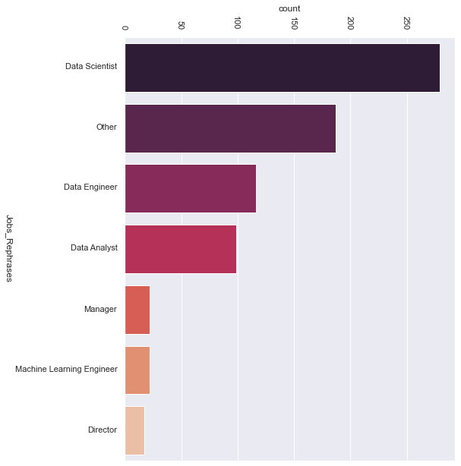
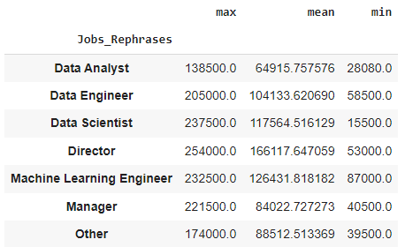
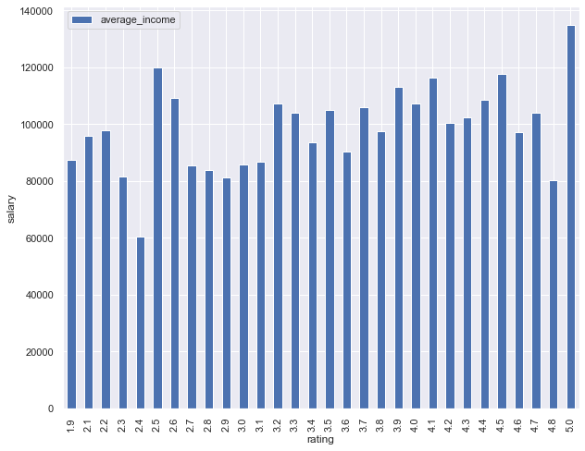
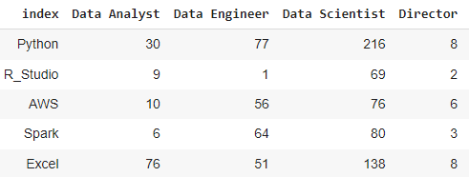
EXPLORATORY DATA ANALYSIS
Figure-2: Maximum, Mean and Minimum Salary in each Data Science Role
Figure-1: Bar Graph of Number of Jobs in each Data Science Role.
Figure-3: Bar Graph of the rating of the Employer against the average income at their company.
Figure-4: Top skills in demand for each job role in the Data Science field

Slide 8
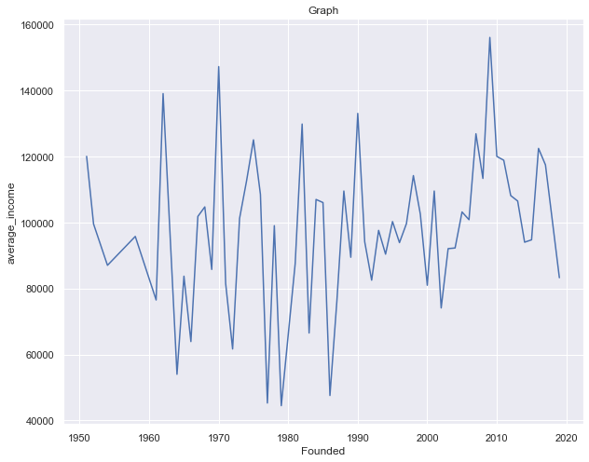
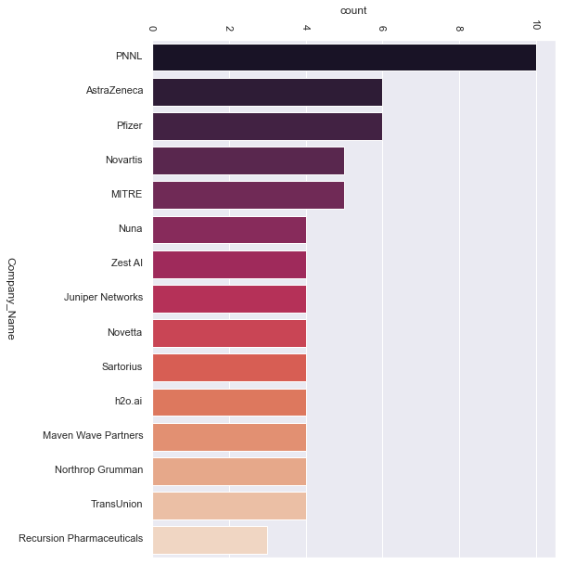
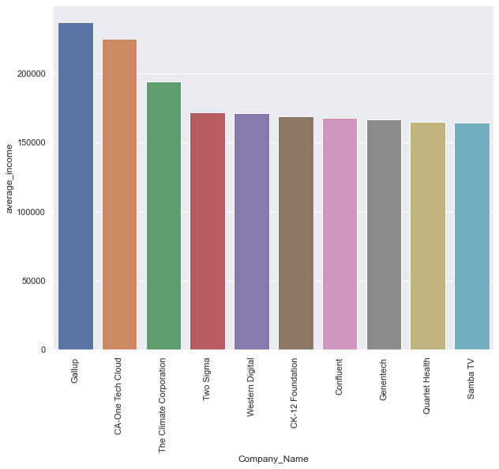
EXPLORATORY DATA ANALYSIS (2)
Figure-5: Line Graph of the year the company was founded against the average income at their company
Figure-6: Bar Graph of the top companies against the average income at their company
Figure-7: Bar Graph of the top 15 companies with highest jobs with the title ‘Data Scientist’

Slide 9
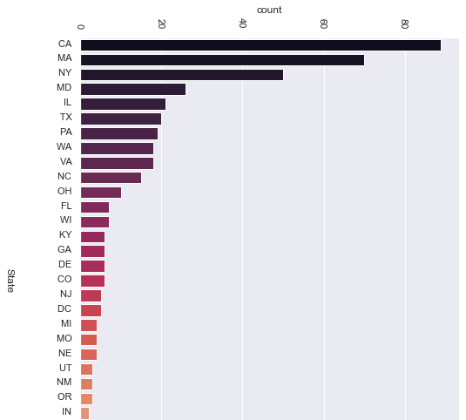
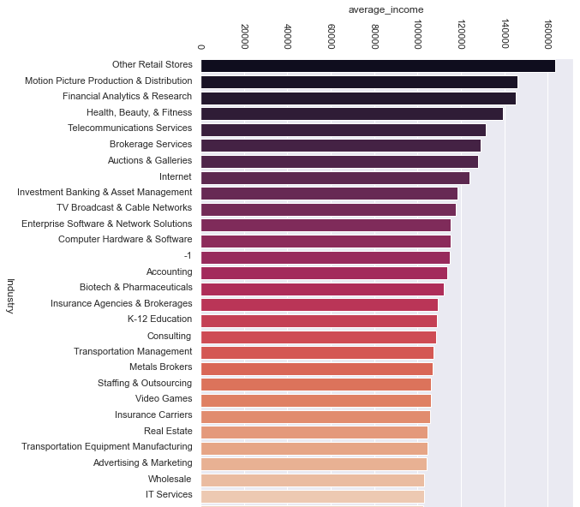
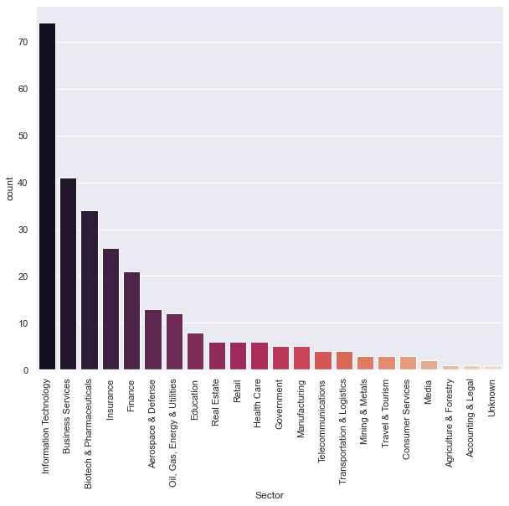
EXPLORATORY DATA ANALYSIS (3)
Figure-8: Bar Graph of the top states in USA with highest jobs with the title ‘Data Scientist’
Figure-9: Bar Graph of the top sectors in which Data Scientist jobs are highest.
Figure-10: Bar Graph of the top industries and their average salary offered

Slide 10
METHODOLOGY
Linear Regression:
One of the most often used predictive modelling approaches is linear regression. The formula is Y = a + bX + e, where an is the intercept, b is the slope of the line, and e is the error term. Based on a given predictor variable, this equation can be used to estimate the value of a target variable (s).
Lasso Regression:
The lasso approach is appealing in prognostic studies because it enhances the quality of predictions by decreasing regression coefficients when relative to predictions based on an unpenalized maximum likelihood model. Parsimony is also accomplished while some variables are set to zero.
Logistic Regression:
Logistic regression is a technique for estimating the variables of a logistic model in regression analysis (a form of binary regression). A binary logistic model mathematically has a dependent variable containing two potential values, such as pass/fail, which is depicted by an indicator variable, with the two values labelled "0" and "1."
Support Vector Classifier:
The classifier that optimizes the margin is the SVM, or support vector machine. In the example below, the purpose of a classifier is to locate a line or (n-1) dimension hyper-plane which divides the two classes in the n-dimensional space.

Slide 11
METHODOLOGY (2)
Decision Tree:
The projected value for regression trees, like the linear model, corresponds to the mean of the region generated by the partition. A prediction will correlate to a category of the result in a classification tree.
Random Forest:
At training, random forests (RF) create a large number of individual decision trees. To create the final forecast, the mode of the classes for categorization or the mean prediction for regression, the predictions from all trees are combined. Ensemble approaches are named for the fact that they make a final conclusion based on a group of outcomes.
Mean Absolute Error:
The Mean Absolute Error (MAE) is a regression model assessment statistic. The mean absolute error of a model with regard to a test set is the average of all individual prediction errors on all instances in the test set. The discrepancy between the real value and the expected value for each occurrence is called a prediction error.

Slide 12
EVALUATION
A Comparative study of the performance of Machine Learning Algorithms in predicting the Average Salary of a Data Scientist Job Role:
The Validation score for the Logistic Regression model built was 0.289 Mean Absolute Error of 19.921
The Validation score for the Logistic Regression model built was 0.358 with Mean Absolute Error of 16.296
The Mean Absolute Error for the Lasso Regression model built was 18.948 with Validation score being 0.383
The Validation score for SVC model was 0.282 whereas the validation score for SVC Bagged model was 0.371. Their Mean Absolute Error was 17.897 and 15.357 respectively
The Validation score for Decision Tree model was 0.7842 with Mean Absolute Error of 13.078
The Validation score for the Random Forest model built was 0.826 with Mean Absolute Error being 11.079

Slide 13
CONCLUSION & FUTURE WORK
The study used its own data scraped from popular job portals and conducted exploratory data analysis .
Highest skills in demand are Python, R-Studio, AWS, Spark, and Excel and they are most commonly found in the roles of Data Scientist, Data Engineer, and Data Analyst in that order.
Retails stores are industry offering the highest average income in Data Science, Information Technology Sector has the highest number of jobs in the aforementioned field.
In the United States, California has the highest number of Data Science Jobs.
Data Scientist is considered the highest paying job in the current market.
Statistically observed that the Random Forest model can accurately predict the salary of a Data Science Job when compared with other ML algorithms.
Test the models with data from other job portals and extend this study to understand the influencing factors of a Data Science Job salary in locations other than USA.

